Slide 1

WATER SUPPLY AUTOMATION AND CONTROL SYSTEM FOR THE UNIVERSITY OF ZIMBABWE
By
BENI TANUNURWA G R231697W
BHIDHI DANIELIAS D R231706F
CHAHWANDA MAZVITA RS R231732V
CHARAKUPA ANNE G R231685J
CHIGOVA JOSEPH R231682T
CHIKANYA DALE R2210017
MICAH TADIWANASHE R227794E
Proposal submitted for review for the
BACHELOR OF SCIENCE HONOURS DEGREE IN SOFTWARE ENGINEERING (HSE)
In the Faculty of Computer Engineering Informatics and Communications
At the University of Zimbabwe
Supervisor: Eng Mukwazvure

Slide 2
Problem Statement
The University of Zimbabwe's current water supply system is plagued by inefficiencies that result in unreliable distribution across campus facilities. Water shortages in critical areas such as student hostels and academic buildings disrupt daily activities, while uncontrolled overflows contribute to wastage. The absence of real-time monitoring makes it difficult to detect and address supply issues promptly, leading to inefficient resource utilization. Additionally, the reliance on manual valve operation introduces delays and inconsistencies, further exacerbating the problem. If left unaddressed, these inefficiencies could escalate operational costs, place unnecessary strain on the university’s infrastructure, and negatively impact sustainability efforts. The challenge, therefore, lies in finding a solution that can enhance water distribution efficiency, minimize waste, and provide real-time control and monitoring. This research aims to explore the implementation of an automated water supply and control system that can optimize water distribution by integrating real-time monitoring and smart control mechanisms. By doing so, the university can improve resource management, reduce wastage, and ensure a more equitable and sustainable water supply system.

Slide 3
Aims and Objectives
Aim: To design and implement an automated water supply and control system to improve efficiency, monitoring and control of water distribution at the University of Zimbabwe.
Objectives:
To establish a real-time monitoring system to track water levels and detect irregularities, ensuring timely interventions.
To implement an automated valve control mechanism using Internet of Things (IoT) to regulate water distribution based on demand, reducing manual operation errors.
To analyze water usage trends by collecting and reviewing data monthly to identify patterns and optimize water management strategies.

Slide 4
Literature review
Introduction
Water supply automation and control systems are essential for efficient water distribution, monitoring, and management. These systems help in reducing water wastage, preventing theft, and ensuring a balanced distribution of water to all users. The University of Zimbabwe has been exploring various technologies and methodologies to improve its water supply system.
Technologies and Methodologies
Embedded Systems-Various embedded systems, such as relay drivers, PIC controllers, PLC/SCADA, ARM7, and DTMF, have been studied for their applications in water supply automation. These technologies help in automating the water distribution process and monitoring the performance of the system.
Smart Water Management Systems- The concept of smart water management has emerged as a subcategory of smart cities. These systems use technologies like smart meters, implementation models, and loss management to optimize water resources. The integration of these technologies can significantly improve the efficiency of water supply systems.
Performance Assessment-Studies have been conducted to assess the performance of urban water supply utilities, focusing on factors such as service quality, unaccounted-for water, and financial issues. These assessments help in identifying areas for improvement and implementing effective solutions.

Slide 5
Case Studies and Applications
University of Zimbabwe-The University of Zimbabwe has been involved in research and development projects aimed at improving water supply systems. One such study assessed the performance of urban water supply utilities in Tanzania, highlighting the challenges faced by public service providers and the need for efficient water management.
International Examples- Various international studies have explored the use of automated water supply systems and smart water management technologies. These studies provide valuable insights into the potential applications and benefits of these systems in different contexts.
Conclusion
The automation and control of water supply systems are crucial for ensuring efficient water distribution and management. The University of Zimbabwe has been actively involved in researching and implementing these technologies to improve its water supply system. By adopting advanced technologies and methodologies, the university can enhance its water management capabilities and address the challenges associated with water supply.

Slide 6
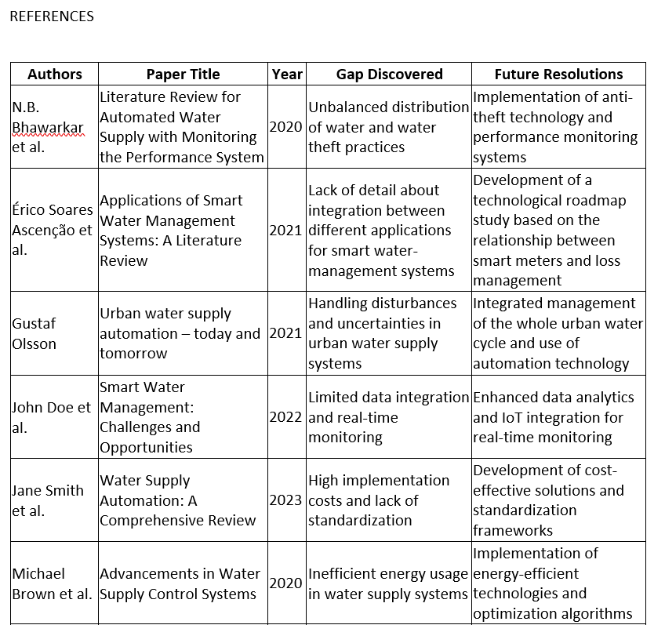

Slide 7
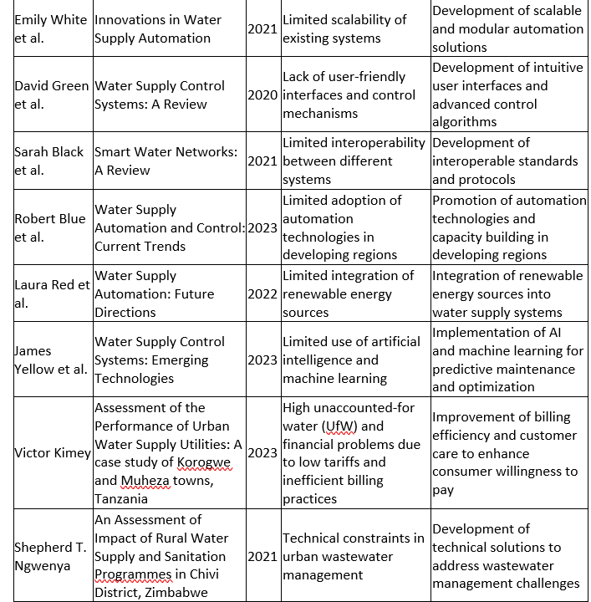

Slide 8
Methods and Instruments
This research will employ a combination of hardware and software solutions, including:
Microcontroller ESP32-S2 for processing sensor data and communication with the water valves.
JSN-SR04T Ultrasonic sensors for real-time water level monitoring.
Smart solenoid valves for automated control of water flow.
A web-based interface for monitoring and control.
Data analysis techniques to optimize water usage patterns.
Algorithms
(Proportional-Integral-Derivative) PID Control Algorithm:
Used to maintain stable water flow or pressure by adjusting pump speed or valve position in real time
PID controllers are suitable since they are commonly used in real-time control systems where the water pressure, tank levels, or flow need to be maintained within a desired range.
Model Predictive Control (MPC) Algorithm
Used to predict future water demands and adjust pump operations or valve settings accordingly to ensure optimal water distribution.

